Slide 1
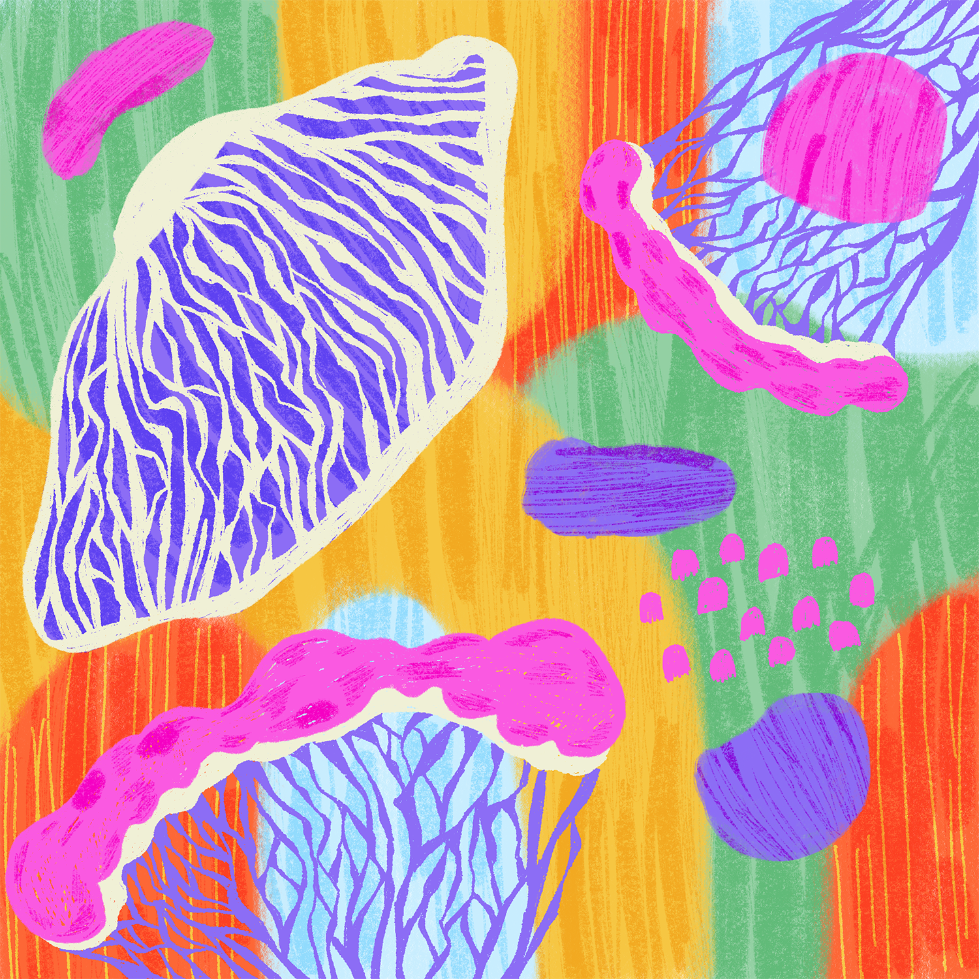

RISE
Key Methods
Used in ERASMUS+ Training course „Resilience, Inclusion, Support, and Empowerment for Youth Workers“ (RISE)
Detailed Step-by-Step Methods for
Supporting Young People and Youth Workers
2025

Slide 2
This document provides fully detailed step-by-step guidance for key methods used in the RISE training course (September 21–26, 2025, Klaipeda, Lithuania), implemented by the Social Sustainability Academy (Socialinio tvarumo akademija, Lithuania) with partners:
Kambuka Kids MTU (Estonia)
Civic Organization "We are the Future" (Ukraine)
Exploring Cultural Campfire Opportunities (Norway)
VESZPRÉM MEGYEI JOGÚ VÁROS ÖNKORMÁNYZATA (Hungary)
GMINA LUBLIN (Poland)

Slide 3
The RISE project focuses on building youth workers’ capacities to support young people facing emotional and mental health challenges — while also strengthening their own well-being and resilience.
The RISE training course applied a range of experiential, creative, and proven approaches to build youth workers’ competencies in supporting young people’s mental health and in safeguarding their own well-being. The emphasis was on active contribution, participation, reflection and practice-based learning rather than purely theoretical instruction.
UNDERSTANDING
Purpose

Slide 4
1. Creating a Welcoming and Safe Atmosphere
2. Team-Building Exercises
Human Barometer
Comfort Zones
Zoom Activity
3. Role Plays
4. First Psychological Aid Bingo
5. Workshops and Peer Exchange
6. Creative and Art-Based Techniques
Art Therapy Cards Exercise
Film Analysis Exercise
7. Experiential, Movement, and Icebreaker Activities
Morning Movement or Dance Exercises
Choose Your Corner
8. Mindfulness, Resilience, and Well-Being Practices
9. Collaborative Idea Generation (Creative Idea Lab)
10. Field Visits and Observation
THE KEY METHODS USED
and How to Apply Them

Slide 5
1. CREATING A WELCOMING AND SAFE ATMOSPHERE
PURPOSE
STEP-BY-STEP
Build trust, reduce anxiety, and engage participants
Give each participant a name sticker with a prompt: “As a youth worker, I like…” or “One strength I bring is…”.
Have participants place stickers visibly and introduce themselves using their sentence.
Conduct a question-swap exercise with prepared reflective question cards.
Observe and ensure voluntary sharing.
RESOURCES
Name stickers, markers, icebreaker cards.
Duration: 20–30 minutes
OUTCOME
Participants feel included and ready to engage

Slide 6
2. TEAM-BUILDING EXERCISES
Human Barometer
PURPOSE
STEP-BY-STEP
Make abstract opinions or attitudes visible and spark dialogue
Select a statement or question relevant to youth work (e.g., “I feel confident managing a crisis situation”).
Place a line on the floor or use tape to indicate a continuum from “strongly disagree” to “strongly agree.”
Ask participants to physically position themselves along the line according to their stance.
Once positioned, participants discuss in pairs or small groups why they chose that position.
Invite volunteers to share insights with the whole group.
Facilitator reflects on patterns and observations.
Adaptation Tips: Use statements of varying complexity for beginners or advanced groups; can be done indoors or outdoors.
RESOURCES
Tools to make visible line
Duration: 20–30 minutes
OUTCOME
Participants visualize diversity of opinions, improve dialogue and reflection.

Slide 7
2. TEAM-BUILDING EXERCISES
Comfort Zones
PURPOSE
STEP-BY-STEP
Raise self-awareness about individual comfort with challenging scenarios and build resilience
Prepare a set of challenging youth work situations (e.g., approaching distressed youth, discussing mental health, handling conflict).
Participants indicate their comfort level using a scale (physically moving on a line or using cards from “very uncomfortable” to “very comfortable”).
Encourage small group discussions on strategies to expand comfort zones.
Facilitator introduces techniques for stress management, self-care, or gradual exposure.
Optionally, create a reflection sheet for participants to record insights and action steps.
Adaptation Tips: Can use hypothetical or real scenarios depending on group experience; include reflection discussion for deeper learning.
RESOURCES
Tools to make visible lines or circles with comfort zones
Duration: 20–30 minutes
OUTCOME
Participants gain insight into personal boundaries, build resilience, and develop coping strategies

Slide 8
2. TEAM-BUILDING EXERCISES
Zoom Activity
PURPOSE
STEP-BY-STEP
Develop perspective-taking, collaboration, and communication skills using visual storytelling. Problem Solving & Communication Exercise
Hand out one picture per person (make sure a continuous sequence is used).
Explain that participants may only look at their own pictures and must keep their pictures Provide each participant with a hidden illustration from Zoom or Re-Zoom.
Participants describe their image verbally, without gestures or showing it.
Group collaborates to reconstruct the intended sequence of images based on descriptions.
Reveal the actual images to compare and discuss differences.
Debrief: discuss challenges in communication, perspective-taking, and collaboration.
Adaptation Tips: Can be adapted for smaller or larger groups by adjusting the number of illustrations; digital versions possible using slides or QR codes; additional reflection prompts can be added for advanced participants.
RESOURCES
"Zoom" and "Re-Zoom" by Istvan Banyai consist of 30 sequential "pictures within pictures":
https://www.scribd.com/document/414526961/281569341-Zoom-Activity-Istvan-Banyai
OUTCOME
Enhances teamwork, creative problem-solving, communication clarity, and empathy.

Slide 9
3. ROLE PLAYS
STEP-BY-STEP
PURPOSE
Divide participants into small groups (3–5 people) to ensure everyone has a role.
Assign roles: youth worker, young person, and one or more observers.
Distribute scenario cards to each group with a written description of the youth situation.
Allow 2–3 minutes for participants to read and understand the scenario.
Role-play the scenario for 5–10 minutes, encouraging realistic reactions and dialogue.
Observers take notes on communication, emotional support, body language, and strategies used.
After the role-play, observers provide constructive feedback using a structured format: what went well, areas for improvement, suggestions for alternative approaches.
Rotate roles so each participant experiences being a youth worker, a young person, and an observer.
Repeat role-play with the same or a new scenario to practice multiple skills.
Conclude with a group reflection: discuss emotions, challenges faced, lessons learned, and how the skills can be applied in real youth work contexts.
Practice youth intervention skills, empathy, problem-solving, and effective communication.
RESOURCES
Scenario cards depicting common youth challenges (e.g., anxiety, bullying, stress, conflict), optional props (to simulate settings or objects), open space for movement
Duration: 20–40 depends on scenarios
OUTCOME
Participants gain confidence, develop practical intervention and communication skills, improve empathy, and learn problem-solving strategies in youth work scenarios.

Slide 10
3. ROLE PLAYS
SCENARIO EXAMPLES
HOW TO ADAPT
For beginners: use simpler, more familiar scenarios.
For advanced participants: introduce complex or multi-layered scenarios including group conflict, trauma, or crisis situations.
Props can be used to simulate real-life environments, objects, or tools.
Anxious Teen: A 15-year-old expresses feeling constant anxiety about school performance and social relationships. They avoid classes and isolate themselves at breaks. The youth worker must help them articulate feelings and suggest coping strategies.
Cyberbullying: A 14-year-old reports being bullied online by peers. They are upset and reluctant to tell parents. The youth worker supports them in managing emotions, documenting incidents, and creating a safe action plan.
Conflict with Peers: Two teens are in constant conflict at a youth club, disrupting activities. The youth worker facilitates communication, mediates the conflict, and encourages empathy and problem-solving.
Stress & Overload: A 16-year-old juggles school, part-time work, and family responsibilities, showing signs of burnout and irritability. The youth worker helps identify stressors, plan manageable routines, and introduce self-care techniques.
Trauma Trigger: A refugee teen reacts strongly to a seemingly minor event, showing signs of past trauma (e.g., withdrawal, aggression). The youth worker practices trauma-informed communication, grounding techniques, and safe emotional expression.
EVALUATION TIPS
Use reflection sheets for participants to self-assess their performance.
Encourage peer feedback focusing on constructive suggestions.
Facilitator can observe patterns and highlight effective strategies.

Slide 11
4. FIRST PSYCHOLOGICAL AID BINGO
STEP-BY-STEP
Preparation:
Prepare bingo cards with a 5x5 grid (or appropriate size) filled with different psychological first aid actions.
Prepare scenario cards or a list of situations that youth workers might encounter (see examples below).
Distribution:
Hand each participant a bingo card and a marker.
Explain the rules: participants will mark actions on their card that are appropriate responses to scenarios you read aloud.
Gameplay:
Read aloud a scenario or a question. Example: “A 15-year-old comes to you saying they feel hopeless and have considered self-harm.”
Participants identify the correct psychological first aid actions (e.g., “Listen actively,” “Ask about risk,” “Provide reassurance”) and mark them on their bingo card.
Continue reading multiple scenarios, allowing participants to mark actions that appear in their cards.
PURPOSE
Interactive learning of psychological first aid principles; helps participants recognize appropriate responses to common youth mental health situations
RESOURCES
Bingo cards with mental health actions or responses (e.g., “Listen actively,” “Check for immediate risk,” “Provide reassurance,” “Refer to a specialist”). Markers or pens. Scenario cards describing realistic youth situations.
OUTCOME
Reinforces core psychological first aid principles. Builds confidence in responding appropriately to youth in distress. Encourages active learning, discussion, and critical thinking in a safe, interactive format.

Slide 12
4. FIRST PSYCHOLOGICAL AID BINGO
SCENARIO EXAMPLES
Anxious Teen: A teen is pacing and wringing their hands, expressing fear about an upcoming exam.
Appropriate responses: Listen actively, validate feelings, suggest grounding techniques, refer to counselor if needed.
Cyberbullying Incident: A teen shows you hurtful messages on social media.
Appropriate responses: Listen without judgment, assess immediate risk, provide reassurance, guide on safe online behavior, inform parents/guardians if necessary.
Panic Attack: A teen suddenly becomes short of breath and panicked during a group activity.
Appropriate responses: Stay calm, help them regulate breathing, remove from stressful environment if needed, reassure and monitor until stable.
Conflict Between Peers: Two teens are yelling at each other in a common area.
Appropriate responses: Ensure safety, intervene calmly, separate parties, listen to each side, mediate discussion if appropriate.
STEP-BY-STEP
Discussion:
After each scenario, pause to discuss:
Which actions were appropriate and why.
Which responses were incorrect or less helpful and why.
Encourage participants to explain their reasoning and share personal experiences.
Completion:
The game can end when a participant achieves “bingo” (a full row, column, or diagonal) or after all scenarios have been discussed.
Highlight key learning points for each scenario, reinforcing psychological first aid principles.

Slide 13
5. WORKSHOPS AND PEER EXCHANGE
STEP-BY-STEP
Divide participants into small groups of 4–6 people to ensure active participation.
Mix participants from different countries or organizations to encourage intercultural exchange.
Provide a discussion prompt, challenge question, or scenario. Example prompts:
“Identify the top three barriers youth face in accessing mental health support in your community.”
“Co-create strategies for engaging refugee youth in non-formal education activities.”
“Design a one-day workshop promoting emotional resilience for teenagers.”
4. Groups discuss the prompt and document their ideas using flipcharts and sticky notes.
5. Encourage everyone to contribute, ensuring quieter participants have space to share.
6. Facilitators circulate, observe, and support groups as needed, without directing content.
7. Ask groups to categorize ideas into themes, priorities, or actionable steps.
8. Encourage them to consider feasibility, resources needed, and potential impact.
PURPOSE
Co-create solutions, share knowledge, enhance intercultural learning, and encourage collaborative problem-solving
RESOURCES
Flipcharts or large sheets of paper
Sticky notes or index cards
Markers, pens, and tape
Optional: timers, templates for documenting ideas
OUTCOME
Encourages peer learning and exchange of best practices.
Strengthens intercultural understanding and collaborative skills.
Generates actionable ideas and solutions that can be implemented in participants’ organizations.

Slide 14
5. WORKSHOPS AND PEER EXCHANGE
SCENARIO EXAMPLES
Youth Mental Health: Groups brainstorm peer support interventions for teens showing anxiety or depression.
Digital Safety: Participants co-create guidelines for online safety education in youth programs.
Conflict Resolution: Design strategies to address peer conflict in multicultural youth clubs.
STEP-BY-STEP
9. Each group presents their findings or solutions to the whole workshop.
10. Facilitator guides a reflective discussion:
Compare similarities and differences between group ideas.
Discuss innovative or unexpected approaches.
Highlight intercultural perspectives and lessons learned.
Optional Extension:
Have participants vote on the most practical, innovative, or transferable ideas.
Collect all flipcharts and notes to create a shared resource for later use.
HOW TO ADAPT
For beginners: use simpler prompts or pre-defined options to guide discussion.
For advanced participants: use open-ended challenges or real-life case studies to promote deeper problem-solving.
Can be conducted online using collaborative tools like Miro, Jamboard, or shared Google Docs.

Slide 15
6. CREATIVE AND ART-BASED TECHNIQUES
Art Therapy Cards Exercise
PURPOSE
STEP-BY-STEP
Facilitate emotional expression, reflection, and non-verbal communication.Enhance empathy, self-awareness, and communication skills among youth workers.
Explain the purpose of creative techniques: expressing thoughts and feelings safely, reflecting on experiences, and fostering discussion.
Encourage openness and respect; there are no “wrong” creations.
Each participant selects a metaphorical card depicting an emotion, situation, or challenge.
Using drawing, painting, or modeling with clay, participants create a visual representation of their interpretation of the card.
Optional: work individually first, then share in small groups to explain their choices and creative process.
Reflection prompts:
“What does this creation tell me about my feelings or approach to youth work?”
“How might this insight help me support a young person facing similar emotions?”
RESOURCES
Paper, cardboard, colored pencils, markers, paints, clay/plasticine.
Metaphorical or art therapy cards with prompts (e.g., emotions, challenges, relationships).
OUTCOME
Participants develop empathy and emotional intelligence.
Improves non-verbal communication and reflective skills.

Slide 16
6. CREATIVE AND ART-BASED TECHNIQUES
Film Analysis Exercise
PURPOSE
STEP-BY-STEP
Encourage creative problem-solving and understanding of diverse youth experiences
Show a short film clip (2–5 minutes) depicting a youth facing challenges such as stress, bullying, or trauma.
Ask participants to observe non-verbal cues, emotions, and reactions.
Facilitate discussion:
How does the young person express emotions?
What interventions could a youth worker apply?
How might cultural context affect responses?
Optionally, have participants create a visual representation or storyboard of key moments from the film and discuss insights.
RESOURCES
Short film clips or videos depicting youth challenges or mental health scenarios.
Reflection sheets or journals.
OUTCOME
Encourages innovative thinking and the application of creative methods to real youth work challenges

Slide 17
7. EXPERIENTIAL, MOVEMENT, AND ICEBREAKER ACTIVITIES
Morning Movement or Dance Exercises
PURPOSE
STEP-BY-STEP
Energize participants and increase alertness. Encourage engagement, collaboration, and comfort within the group. Promote social interaction, trust-building, and group cohesion.
Explain that these activities are designed to energize participants and create a safe, interactive, and engaging environment.
Emphasize that participation is encouraged but voluntary for those who may feel uncomfortable with movement.
Play upbeat music.
Lead participants through simple stretching, group dance moves, or coordinated movement exercises.
Encourage participants to express themselves through movement while maintaining respect for personal space.
Optional variation: assign participants to create their own movement sequence in pairs or small groups.
RESOURCES
Open space for movement.
Music player with speakers (optional)
OUTCOME
Participants feel energized, comfortable, and more engaged in group activities.
Builds trust, social cohesion, and readiness for collaborative learning.

Slide 18
7. EXPERIENTIAL, MOVEMENT, AND ICEBREAKER ACTIVITIES
Choose Your Corner
PURPOSE
STEP-BY-STEP
Energize participants and increase alertness. Encourage engagement, collaboration, and comfort within the group. Promote social interaction, trust-building, and group cohesion.
Label four corners of the room with different options (A/B/C/D) corresponding to answers or opinions.
Ask a multiple-choice question or present a statement, e.g.:
“Which approach do you use most often when supporting youth: Listening / Advising / Encouraging / Observing?”
“How comfortable are you facilitating group discussions? Very comfortable / Somewhat comfortable / Neutral / Uncomfortable”
Participants move to the corner representing their answer.
Encourage discussion within corners about why they chose that option.
Optional: ask a volunteer from each corner to summarize key points to the whole group.
RESOURCES
Flipcharts or signs for marking areas
OUTCOME
Provides techniques participants can directly apply with youth to promote inclusion, engagement, and group interaction

Slide 19
8. MINDFULNESS, RESILIENCE, AND WELL-BEING PRACTICES
STEP-BY-STEP
Introduction (2–3 minutes):
Explain the purpose of mindfulness and resilience exercises: to improve awareness, emotional regulation, and stress management.
Encourage participants to approach exercises with an open mind and without judgment.
Breathing and Mindfulness Exercise (5–10 minutes):
Ask participants to sit or lie comfortably on yoga mats.
Guide them through a simple breathing exercise: inhale for 4 counts, hold for 2, exhale for 6.
Optional: introduce a body-scan meditation where participants notice sensations in different parts of their body.
Encourage reflection on thoughts and feelings that arise during the practice.
Guided Visualization or Relaxation (5–10 minutes):
Play soft music or use a quiet environment.
Guide participants through a visualization scenario, e.g., imagining a safe, calm place or visualizing successfully handling a challenging youth situation.
Encourage participants to notice emotions, thoughts, and physical sensations during the exercise.
PURPOSE
Strengthen emotional regulation, stress management, and personal resilience. Provide practical tools youth workers can apply with themselves and with young people. Encourage self-care practices that improve professional sustainability.
RESOURCES
Yoga mats or soft floor space.
Guided meditation or mindfulness scripts/audio recordings.
Timer or clock to structure exercises.
Journals or reflection sheets.
OUTCOME
Participants develop skills for self-care, emotional regulation, and stress management. Builds resilience for youth workers, reducing burnout risk. Provides practical, repeatable techniques for supporting young people’s mental health.

Slide 20
9. COLLABORATIVE IDEA GENERATION (CREATIVE IDEA LAB)
PURPOSE
STEP-BY-STEP
Foster critical thinking, problem-solving, and innovation.
Encourage co-creation and collaborative learning among participants. Generate practical solutions applicable to real-world youth work challenges.
Introduction (5 minutes):
Explain the purpose of the Creative Idea Lab: participants will collaboratively identify challenges, brainstorm solutions, and refine ideas.
Emphasize open-mindedness, respect for all ideas, and the principle of “no wrong answers.”
Identify Challenges (5–10 minutes):
Ask participants to individually write down challenges they encounter in youth work on sticky notes (one challenge per note).
Encourage specificity, e.g., “Teenagers avoiding mental health support” instead of “Youth problems.”
Share and Categorize Challenges (5–10 minutes):
Participants place their sticky notes on a wall, flipchart, or board.
In groups, cluster similar challenges into categories or themes (e.g., engagement, mental health, digital risks, family involvement).
RESOURCES
Sticky notes or index cards. Markers or pens Flipcharts, whiteboards, or large sheets of paper. Optional: templates for organizing ideas (categories, priorities, or themes)
OUTCOME
Participants develop practical problem-solving and collaboration skills. Generates actionable strategies for youth work challenges. Encourages ownership, critical thinking, and intercultural exchange.

Slide 21
9. COLLABORATIVE IDEA GENERATION (CREATIVE IDEA LAB)
STEP-BY-STEP
SCENARIO EXAMPLES
Brainstorm Solutions (10–15 minutes):
Groups select a challenge or category and brainstorm as many solutions as possible.
Encourage creative, innovative, and practical ideas.
Write one idea per sticky note, using clear, actionable language.
Exchange and Refine Ideas (5–10 minutes):
Groups swap their solution notes with another group.
Each group adds suggestions, improvements, or alternative approaches to the ideas they received.
Repeat if desired to maximize collaboration.
Presentation and Discussion (5–10 minutes):
Groups present refined solutions to the whole workshop.
Facilitator guides discussion on applicability, feasibility, and potential impact.
Optionally, participants vote on the most innovative or implementable solutions.
Engaging Refugee Youth: Brainstorm methods to increase participation in after-school programs.
Mental Health Awareness: Generate ideas for interactive campaigns targeting teen anxiety and stress.
Conflict Mediation: Co-create strategies to resolve peer conflicts in multicultural youth clubs.
Digital Literacy: Develop tools for promoting safe and balanced technology use among adolescents.
HOW TO ADAPT
For beginners: provide example challenges and suggested categories to structure brainstorming.
For advanced participants: include real-life case studies requiring multi-step solutions.

Slide 22
10. FIELD VISITS AND OBSERVATION
STEP-BY-STEP
Preparation (Before Visit):
Contact the organization to schedule the visit and clarify activities participants will observe.
Prepare observation templates or checklists focusing on areas such as:
Youth engagement methods
Group dynamics and participation
Staff approaches to conflict or emotional support
Integration of creative or non-formal activities
Explain to participants the purpose of the visit and encourage active observation and note-taking.
During the Visit:
Observe activities quietly and respectfully.
Note both successful strategies and areas for potential improvement.
Optional: ask permission to ask clarifying questions during breaks or after the session.
Focus on interactions, facilitation methods, safety measures, and how youth workers manage challenges.
Guided Reflection Post-Visit (15–20 minutes):
Immediately after the visit, participants reflect individually or in small groups on key insights.
Reflection prompts:
“What strategies were most effective in engaging youth?”
“How could I apply these approaches in my context?”
PURPOSE
Connect theoretical knowledge and practical youth work experiences. Enable participants to observe real-life strategies, organizational practices, and youth engagement methods. Foster reflective learning and application of best practices in participants’ own contexts.
RESOURCES
Access to youth organizations, community centers, or educational institutions.
OUTCOME
Participants gain firsthand insight into effective youth engagement and support practices. Bridges the gap between theory and practice, reinforcing learning. Provides a foundation for implementing improved strategies and innovative approaches in participants’ organizations.

Slide 23
In
SUMMARY
The methods presented provide practical and adaptable tools for supporting youth well-being, inclusion, and resilience.
Each approach encourages active participation, reflection, and emotional safety.
Facilitators are encouraged to adapt and combine methods according to group needs and context.
Together, we can build resilient, inclusive, and supportive communities

